Slide 1
Data Structures and Algorithms IICT-6005
Lesson 2 - Recursion

Slide 2
Lesson Content
What is recursion?
Recursion in programing
Recursion example
Why is recursion useful?
Recursion exercises

Slide 3
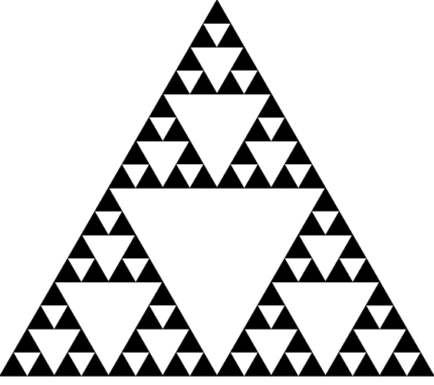
What is Recursion?
Recursion is a Divide and Conquer Problem.
A recursive item is something which is defined (or described) and/or solved in terms of itself.
That is, the description or solution for some problem is re-used as part of the same description or problem.
3
Notes:
4/1/2020
3
3

Slide 4
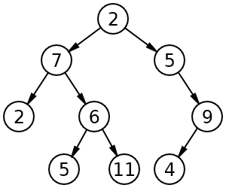
What is Recursion?
Main tree
Recursion can also be used to define mathematical concepts:
A tree is a node with 0 or more children. Each child node in a tree can also have 0 or more children.
Therefore, based on this definition, each child node can represent another smaller tree (called a sub-tree) within the main tree.
Mathematical Sequences such as the Factorial Sequence of a number or the Fibonacci Sequence are also recursive.
Sub tree
4
Notes:
4/1/2020
4
4

Slide 5
What is Recursion?
Recursion can also be used to define
mathematical concepts:
Factorial Sequences
Fibonacci Sequence
Factorial (5) = 5 x 4 x 3 x 2 x1
Fibonacci(5) = 5 + 4 + 3 + 2 + 1
5
Notes:
4/1/2020
5
5

Slide 6
What is Recursion?
Example:
Fibonacci of 5 = 5 + 4 + 3 + 2 + 1
So Fibonacci of 5 = 5 + Fibonacci of 4 (which is 4 + 3 + 2 + 1)
Which implies that the Fibonacci of 5 = 5 + 4 + Fibonacci of 3
Therefore the Fibonacci Function of a number F(n) can be defined as the sum of that number and the Fibonacci Function of the number before it
F(n) = n + F(n-1)
How can we solve the Fibonacci Function of F(n-1)?
We keep on breaking down the problem until it is small enough to solve!
We then re-use our answer to solve the previous problem and back track until we have solved the final problem
6
Notes:
4/1/2020
6
6

Slide 7
What is Recursion?
Example:
Fibonacci of 5
= 5 + Fibonacci of 4
= 5 + 10 = 15
Fibonacci of 4
= 4 + Fibonacci of 3
= 4 + 6 = 10
Fibonacci of 3
= 3 + Fibonacci of 2
= 3 + 3 = 6
Fibonacci of 2
= 2 + Fibonacci of 1
= 2 + 1 = 3
Fibonacci of 1
= 1
7
Notes:
4/1/2020
7
7

Slide 8
Recursion in Programming
A Recursive Method is a method that calls itself.
Hence a Recursive Algorithm can be defined as an algorithm which calls itself with "smaller (or simpler)" input values, and which obtains the result for the current input by applying simple operations to the returned value for the smaller (or simpler) input.
Informally, you can imagine that the method is calling itself because it is assuming that it already works (at least for a problem with a “simpler” input).
Each time, the problem is slightly simplified (e.g. in the Fibonacci sequence we are looking for terms that are simpler to calculate each time).
The method will keep on calling itself, each time encountering a simpler problem, until it meets a trivial problem that it can solve directly
E.g. the Fibonacci Sequence of 1 which is equal to 1

Slide 9
Recursion in Programming
Recursive Algorithms are essentially Divide and Conquer Problems where, to find a solution to the given problem, one must:
Breaking the main problem into sub-problems (that are themselves smaller instances of the same problem)
Recursively solving these sub-problems
Appropriately combining their answers

Slide 10
Recursion in Programming
Recursive Algorithms have 3 parts to their problem :
Base Case
Making Progress
Recursive Call
Base Case (i.e., when to stop)
This is the solution to the "simplest" possible problem e.g. when working out Fibonacci Sequence of a number using Recursion, the simplest possible case is an input of 1 i.e. work out 1!
When the Base Case is reached the recursion stops.

Slide 11
Recursion in Programming
Making Progress (i.e., Work toward Base Case)
This is the part which attempts to make the problem simpler by providing smaller inputs i.e. we work towards creating sub-problems of the same type as the main problem.
Example:
When working out the Fibonacci Sequence of a number (n), we simplified the problem by adding the current value of n with the Fibonacci Sequence of the number right after it i.e. (n-1)
Therefore, Fibonacci (5) = 5 +Fibonacci(4)
Which also means that Fibonacci (4) = 4 + Fibonacci (3)..etc.

Slide 12
Recursion in Programming
Recursive Call (i.e., call ourselves)
The simpler problem created by the previous step is solved by calling the function itself e.g. to solve Fibonacci (n) = n + Fibonacci (n-1)
You solve Fibonacci(n-1) by calling the Fibonacci function itself and this time passing n-1 as a parameter instead of n.
This happens repeatedly until n = 1, meaning that the base case has been reached, and the recursion stops.

Slide 13
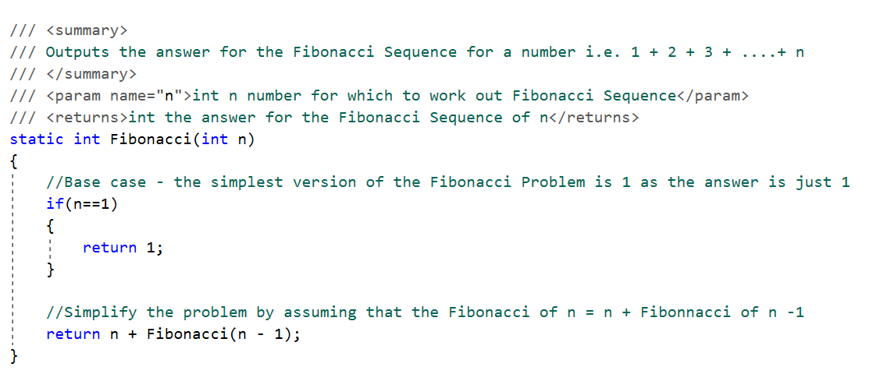
Recursion example
13
Notes:
4/1/2020
13
13

Slide 14
Why is Recursion Useful?
Many Recursive Algorithms can also be written iteratively i.e. we avoid having a method that calls itself and use loops instead.
However:
Recursive algorithm have shorter code making it easier to define, implement and analyze the algorithm in question.
Recursive algorithms often outperform their iterative version for larger input sizes
Example :
The Factorial of a number can be worked out either using recursion or using a for loop
But as the number for which the Factorial is worked out gets bigger, the cost of checking the stopping condition in the loop and incrementing the loop counter exceeds the number of operations required to re-execute the method for a smaller number
Hence, as the value of n gets bigger, the recursive factorial will have better timing results than the iterative version
14
Notes:
4/1/2020
14
14

Slide 15
Trade Off
Recursion requires the method to be copied multiple times in memory, so although it might be faster than the iterative verso it also uses up a lot more memory!
Which is best?
It depends on what we can sacrifice!
If memory is not an issue, we implement recursively to gain speed
BUT
If we need to be careful with our memory management e.g. algorithm will be executed on a microprocessor with limited memory, the we have to think twice about recursion.
15
Notes:
4/1/2020
15
15

Slide 16
Recursion exercises
Attempt the following exercises using Recursion:
Implement a method that returns the value of n! (Factorial n)
Example : 5! = 5 x 4 x 3 x 2 x 1
Write a program to generate the following pattern using * based on the value of n inputted as parameter
Example :
if n = 5 then the output is
***** (5) **** (4) *** (3) ** (2) * (1)

Slide 17
Recursion exercises
Attempt the following exercises using Recursion:
Write a program to generate all variations with duplicates of n elements class k.
Example :
if n = 3 and k = 2, then the output is
(1 1), (1 2), (1 3), (2 1), (2 2), (2 3), (3 1), (3 2), (3 3)

Slide 18
End of lesson
Any questions?

